Slide 1

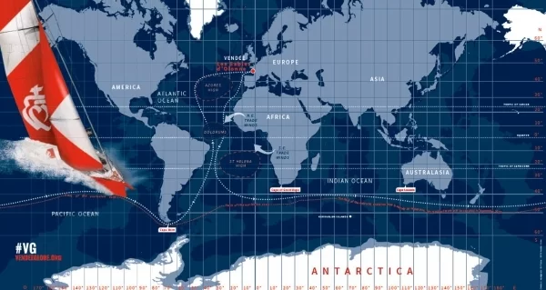

Vendee Globe
Group 5
Marc van Waes - Riya Chacko - Robena Sahetapy

Slide 2
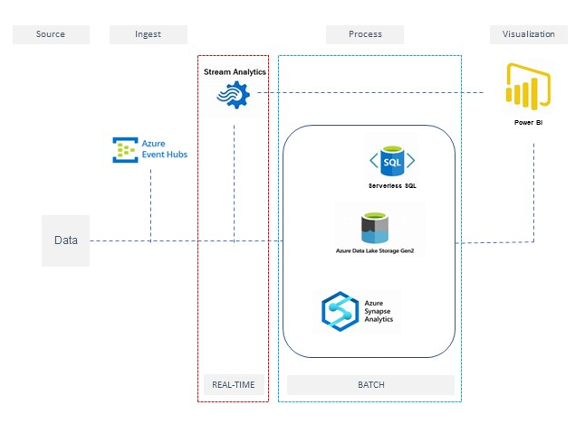
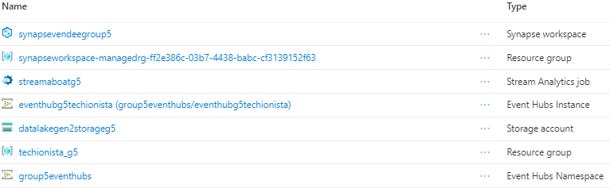
Overview Vendee Lambda architecture
Overview architecture
Overview azure

Slide 3
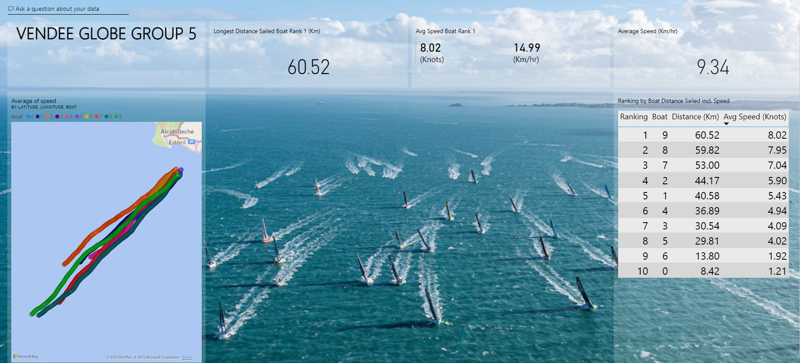
Dashboard

Slide 4
Dashboard
https://app.powerbi.com/groups/43ebc70d-6653-46c4-bab6-c90c38e3cc6c/dashboards/fdbca515-8e54-47c4-84cb-a475f5082fce?language=en-US

Slide 5
Situation 1 – Live stream
Situation:
Get the live stream functioning and visualize in Power BI.
Task:
Be able to stream live data from event hub to Power BI.
Action:
Initially it didn’t function. We were able to produce the live stream however couldn’t visualize it in Power BI. Reason was that we were not able to create a direct link out of Power BI workspace to Azure Stream.
Result:
Instead of directly streaming from Power BI workspace we’ve connected through Power BI desktop.

Slide 6
Situation 2 – Batch data
Situation:
Not able to collect data from the ‘Heading’ column.
Task:
Need to be able to store the batch ‘Heading’ data.
Action:
We have adjusted our SQL script of the stream job in order to ‘force’ the data to be of a certain/defined data type.
Result:
Resolved this situation by applying the ‘TRY_CAST’ in the SQL script.

Slide 7
Situation 3 – Batch and Stream data
Situation:
Modified the query for the lat / long values.
Task:
Need to be able to stream and store the lat/long values in a proper manner.
Action:
Modified query to filter out the ‘odd’ data. Ensuring that lat values will be between -90 and 90 and long values between -180 and 180.
Result:
Receiving the correct data into both stream and storage.

Slide 8
Situation 4 – Output of Stream -> DL
Situation:
The output file was defined as json however not able to process this in CETAS.
Task:
Receive the data in order to process it accordingly.
Action:
Re-defined the output of the file to store in the data lake Gen 2 to parquet.
Result:
Able to create the external table.

Slide 9
Situation 5 – Lead.....or
Situation:
Determine what measure to utilize ‘who is in the lead’ (reference point).
Task:
1) what to use as the reference point?
2) how to calculate the distance?
Action:
1) calculated distance between current and previous boat position based on last measured time
2) Stack-Overflow through Google is your best friend.
Result:
Came up with solid reference points and calculations in order to determine the distance sailed.

Slide 10
Situation 6 – from View to BI
Situation:
A view was created in order to collect processed data however not able to send this to Power BI.
Task:
Needed to push processed data to Power BI in order to visualize.
Action:
Created a linked service with a direct connection to Power BI. Once the connection to linked services was established, we were able to visualize the processed data.
Result:
Finally able to visualize the data in Power BI through the linked services connection.

Slide 11
Situation 7 – Tumbling/Hopping.....
Situation:
Wanted to include window functions however our SQL script was not accepted continuously.
Task:
Include tumbling function in order to have values for a fixed time period and reduce the amount of live stream data.
Action:
Team decision to not proceed with this as we have lost time in order to fix the script (hours), while following the instructions as per Microsoft Learn.
Result:
No window function included in our live stream data.

Slide 12
Reflection
Collaboration
Result
Quick decision making
Consensus
Determination
Learning
Fun
Windows
Time
Practise makes perfect

